Slide 1

P peline
The Data
Machine Learning II: Choosing the Best Algorithm
© Jennifer Mankoff & Nikola Banovic
The Data Pipeline; HCII; Spring 2017
Slides modified & borrowed from Carolyn Rosé
Want to go deeper? http://see.stanford.edu/see/lecturelist.aspx?coll=348ca38a-3a6d-4052-937d-cb017338d7b1
Notes:
XX

Slide 2
Cautionary Tale about p-values
Before you use Null Hypothesis Testing you must see this video:
https://youtu.be/42QuXLucH3Q?t=1m55s

Slide 3
Goals for today
Metrics Overview
How to evaluate ML algorithms
How to pick “the best” one

Slide 4
Two class problem: a simple scenario
Suppose we want to classify a person’s sex based on other demographics data.
For simplicity sake let’s assume that sex is defined as per US Census Bureau and that it is a binary class.
Formalize the problem as a classifier that returns True when the person if female and False when the person is male.

Slide 5
What are the possible outcomes?
PREDICTED/ACTUAL | FEMALE | MALE
FEMALE | TRUE POSITIVE
MALE

Slide 6
What are the possible outcomes?
PREDICTED/ACTUAL | FEMALE | MALE
FEMALE | TRUE POSITIVE | FALSE POSITIVE
MALE

Slide 7
What are the possible outcomes?
PREDICTED/ACTUAL | FEMALE | MALE
FEMALE | TRUE POSITIVE | FALSE POSITIVE
MALE | FALSE NEGATIVE

Slide 8
What are the possible outcomes?
PREDICTED/ACTUAL | FEMALE | MALE
FEMALE | TRUE POSITIVE | FALSE POSITIVE
MALE | FALSE NEGATIVE | TRUE NEGATIVE

Slide 9
How can we tell if classifier is doing well?
How can we measure classifier performance?
PREDICTED/ACTUAL | FEMALE | MALE
FEMALE | TRUE POSITIVE | FALSE POSITIVE
MALE | FALSE NEGATIVE | TRUE NEGATIVE

Slide 10
How can we tell if classifier is doing well?
Accuracy (percentage of time the classifier was correct)
Accuracy = (TP+TN)/(TP+FP+FN+TN)
What are some problems with accuracy?
PREDICTED/ACTUAL | FEMALE | MALE
FEMALE | TRUE POSITIVE | FALSE POSITIVE
MALE | FALSE NEGATIVE | TRUE NEGATIVE

Slide 11
How can we tell if classifier is doing well?
Precision (how many selected items are relevant)
Precision = TP/(TP+FP)
PREDICTED/ACTUAL | FEMALE | MALE
FEMALE | TRUE POSITIVE | FALSE POSITIVE
MALE | FALSE NEGATIVE | TRUE NEGATIVE

Slide 12
How can we tell if classifier is doing well?
Recall (how many relevant items are selected)
Recall = TP/(TP+FN)
PREDICTED/ACTUAL | FEMALE | MALE
FEMALE | TRUE POSITIVE | FALSE POSITIVE
MALE | FALSE NEGATIVE | TRUE NEGATIVE

Slide 13
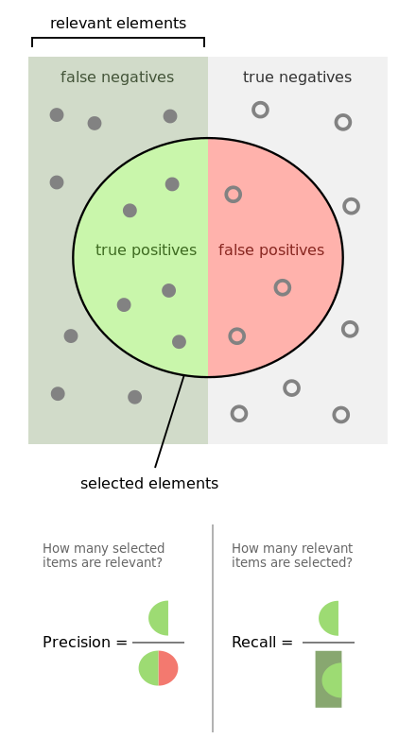
How can we tell if classifier is doing well?
By Walber - Own work, CC BY-SA 4.0, https://commons.wikimedia.org/w/index.php?curid=36926283

Slide 14
How can we tell if classifier is doing well?
Accuracy = (TP+TN)/(TP+FP+FN+TN)
Precision = TP/(TP+FP)
Recall = TP/(TP+FN)
PREDICTED/ACTUAL | FEMALE | MALE
FEMALE | TRUE POSITIVE | FALSE POSITIVE
MALE | FALSE NEGATIVE | TRUE NEGATIVE
Notes:
What do you want to be higher: precision or recall?
(Answer: it depends on the problem. Do not give the answer. Show ROC curve and Precision/Recall Curve and then ask again).

Slide 15
How can we tell if classifier is doing well?
ROC Curve: the curve is created by plotting the true positive rate (recall) against the false positive rate (false alarm) at various threshold settings.
https://en.wikipedia.org/wiki/Receiver_operating_characteristic

Slide 16
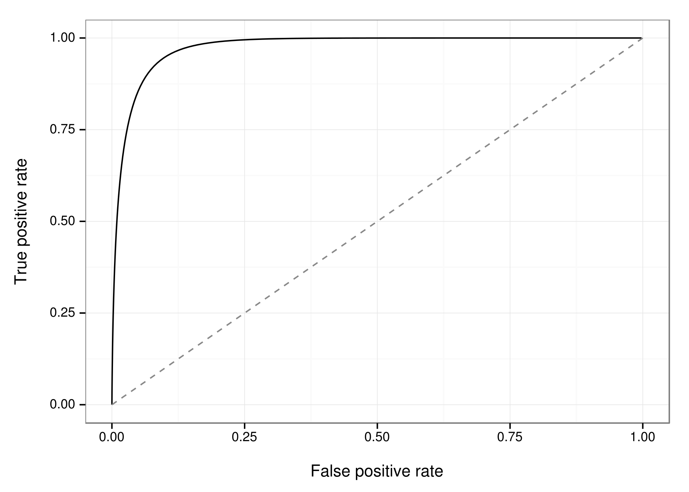
How can we tell if classifier is doing well?
ROC Curve:
USE AREA UNDER THE CURVE
AS A METRIC
By EpochFail (Own work) [CC BY-SA 4.0 (http://creativecommons.org/licenses/by-sa/4.0)], via Wikimedia Commons
Notes:
How do we plot this curve?

Slide 17
How can we tell if classifier is doing well?
Precision/Recall Curve: another (some will say more intuitive) way to represent similar information

Slide 18
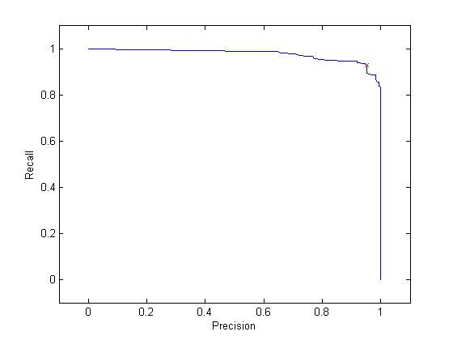
How can we tell if classifier is doing well?
Precision/Recall Curve:
https://web.stanford.edu/group/vista/cgi-bin/wiki/index.php/Misprint_development_notes
Notes:
How do we plot this curve?

Slide 19
How can we tell if classifier is doing well?
We can combine Precision and Recall into a single measure.
Compute harmonic mean of the two.
F-score = 2*(P * R)/(P + R)
Notes:
We said why accuracy can be a poor choice. What are some “problems” that precision and recall (and F-score) have that accuracy does not? (Answer: no direct consideration for TN)

Slide 20
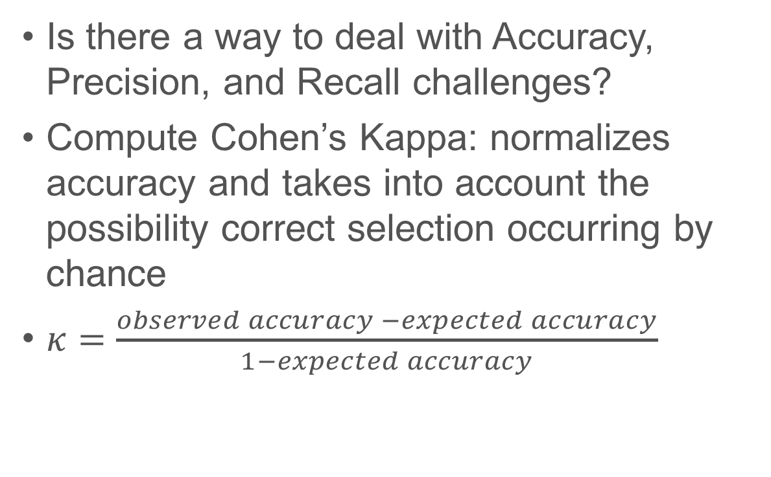
How can we tell if classifier is doing well?
Is there a way to deal with Accuracy, Precision, and Recall challenges?
Compute Cohen’s Kappa: normalizes accuracy and takes into account the possibility correct selection occurring by chance
$κ=\frac{observed accuracy −expected accuracy}{1−expected accuracy}$
https://en.wikipedia.org/wiki/Cohen%27s_kappa
Notes:
We said why accuracy can be a poor choice. What are some “problems” that precision and recall (and F-score) have that accuracy does not? (Answer: no direct consideration for TN)

Slide 21
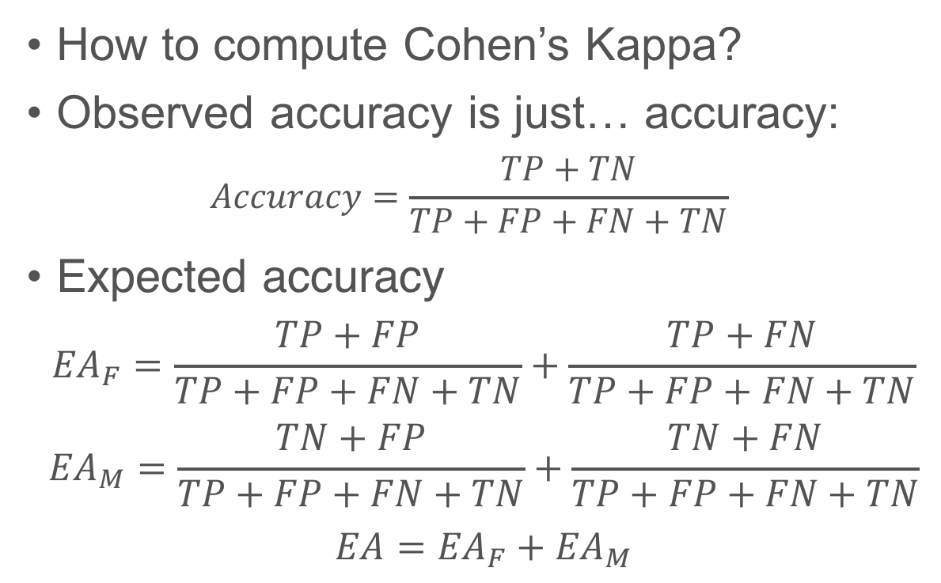
How can we tell if classifier is doing well?
How to compute Cohen’s Kappa?
Observed accuracy is just… accuracy:
$$Accuracy=\frac{TP+TN}{TP+FP+FN+TN}$$
Expected accuracy
$${EA}_{F}=\frac{TP+FP}{TP+FP+FN+TN}+\frac{TP+FN}{TP+FP+FN+TN}$$
$${EA}_{M}=\frac{TN+FP}{TP+FP+FN+TN}+\frac{TN+FN}{TP+FP+FN+TN}$$
$$EA={EA}_{F}+{EA}_{M}$$
https://en.wikipedia.org/wiki/Cohen%27s_kappa

Slide 22
How can we tell if classifier is doing well?
sklearn.metrics: Metrics
Usual format:
metrics.[metric]_score(y_true, y_pred)
metrics.[metric]_score(y_true, y_score)
Example:
metrics.accuracy_score(y_true, y_pred)
http://scikit-learn.org/stable/modules/classes.html#module-sklearn.metrics
Notes:
The reason why I will not go into an example here is because you can easily calculate all these measures using existing libraries.

Slide 23
Take a moment! Talk to your neighbor…
Which metric would you use to compare two different classifiers and pick the best one?

Slide 24
How to compare two classifiers?
Need to avoid overfitting.
A subtle, but important consideration:
Do NOT
evaluate (make a decision)
and
test (estimate error/performance)
on the same data

Slide 25
How to compare two classifiers?
Split data into:
Optimization Set
Training Set
Testing Set
Development:
Train on optimization set, test on training set
Testing/validation:
Train on training set, test on test set

Slide 26
How to compare two classifiers?
Often not enough data. What to do?
Cross Validation
Have multiple “versions” of the same data.
Average the metrics over all folds
Example:
Development using CV on Optimization Set
Testing the same: train on training set, test on test set

Slide 27
How to compare two classifiers?

Slide 28
How to compare two classifiers?

Slide 29
How to compare two classifiers?
Not enough data for optimization set?
Inner-Outer Cross Validation
For each outer fold, do another cross validation.
Optimization decisions on inner CV.
Best algorithm testing on outer CV.
Example: 10 fold outer CV and 10 fold inner CV = 100 folds.

Slide 30
How to compare two classifiers?

Slide 31
How to compare two classifiers?

Slide 32
How to compare two classifiers?

Slide 33
How can we tell if classifier is doing well?
sklearn.model_selection: Model Selection
In the assignment you will be using different functions from this package, including CV.
Use sklearn documentation! It includes good tutorials. E.g., for CV, see:
http://scikit-learn.org/stable/modules/cross_validation.html
http://scikit-learn.org/stable/modules/classes.html#module-sklearn.model_selection
Notes:
The reason why I will not go into an example here is because you can easily calculate all these measures using existing libraries.

Slide 34
How to compare two classifiers?
Each fold gives us a value for a metric of choice.
Pick the classifier with “the best” (e.g., highest) average value.

Slide 35
How to compare two classifiers?
How do we know that we picked the classifier that actually performs the best and not happen by chance?
We don’t! But we can test (with some confidence) that the difference we are seeing did not happen by chance.

Slide 36
A quick intro to NHST
Null Hypothesis Significance Testing
Many disciplines banned NHST!

Slide 37
A quick intro to NHST
Usual setup:
State Null Hypothesis (assume no difference)
E.g., h0: “classifiers c1 and c2 have the same accuracy”
Run an NHST test (e.g., t-test comparing the difference in variance between the two sets of accuracies)
Be careful! Such tests make a lot of assumptions!
The test returns a result (including a p-value)
If p-value less than some alpha (e.g., p < 0.05), we REJECT the null hypothesis, which means that c1 and c2 have different accuracies.
If p >= 0.05, we can’t say anything.

Slide 38
An example: how to compare two classifiers?
Fold | C1 Accuracy | C2 Accuracy
1 | .89 | .96
2 | .88 | .92
3 | .91 | .97
4 | .87 | .96
5 | .88 | .96
6 | .86 | .95
7 | .90 | .98
8 | .85 | .93
9 | .86 | .95
10 | .88 | .96

Slide 39
An example: how to compare two classifiers?

Slide 40
An example: how to compare two classifiers?
t-Test: Paired Two Sample for Means
 | Variable 1 | Variable 2
Mean | 0.878 | 0.954
Variance | 0.000351111 | 0.000315556
Observations | 10 | 10
df | 9
t Stat | -15.23389079
P(T<=t) two-tail | 9.86181E-08

Slide 41
An example: how to compare two classifiers?
t-Test: Paired Two Sample for Means
 | Variable 1 | Variable 2
Mean | 0.878 | 0.954
Variance | 0.000351111 | 0.000315556
Observations | 10 | 10
df | 9
t Stat | -15.23389079
P(T<=t) two-tail | 9.86181E-08

Slide 42
An example: how to compare two classifiers?
t-Test: Paired Two Sample for Means
 | Variable 1 | Variable 2
Mean | 0.878 | 0.954
Variance | 0.000351111 | 0.000315556
Observations | 10 | 10
df | 9
t Stat | -15.23389079
P(T<=t) two-tail | 9.86181E-08

Slide 43
An example: how to compare two classifiers?
Suppose p > 0.05. What then?

Slide 44
An example: how to compare two classifiers?
Byte 4 has one extra step!
You will compare more than two classifiers.
This requires another test for the main effect.
If there is a main effect, need to run pairwise comparison (e.g., using a t-test to compare each pair)
This requires a correction!
You will be using non-parametric tests!

Slide 45
Why don’t we teach you how to compute these yourself?
Because there are libraries to do this!
Statistical functions (scipy.stats)
scipy.stats.wilcoxon(x,y)
You still have to be careful that all assumptions hold!
E.g., that your data is normally distributed if you are using a parametric test.
E.g., that you use a paired test when you use the same data in both conditions (in this case classifiers)
https://docs.scipy.org/doc/scipy-0.15.1/reference/stats.html
Notes:
The reason why I will not go into an example here is because you can easily calculate all these measures using existing libraries.

Slide 46
More on NHST later in the course
More on different uses
More on assumptions
More on what and how to report

Slide 47
How to compare two classifiers?
Questions?

